Slide 1



Car Valuation Engine: Beyond Simple Depreciation
Predicting resale value using data & ML
Yash Gupta | Yash Srivastava
Code and Conquer

Slide 2
🚨 The Problem
Car depreciation is widely misunderstood
Most people assume a linear drop in value
Critical price cliffs (like at 50,000 miles) are hidden
Decisions are based on guesswork, not data
“Wrong timing in resale can cost thousands.”

Slide 3
💡 Our Solution
Built a data-driven car valuation engine
Trained on 50,000+ real-world car records
Captures non-linear depreciation patterns
Predicts both current and future prices
“Not just prediction - a complete valuation system”

Slide 4
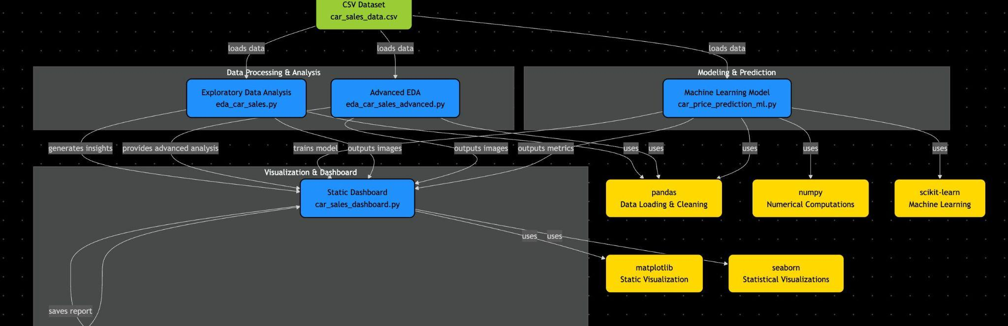
🧠 System Architecture
A modular pipeline transforming raw data into predictive insights
Data → Analysis → Model → Simulation → Dashboard

Slide 5
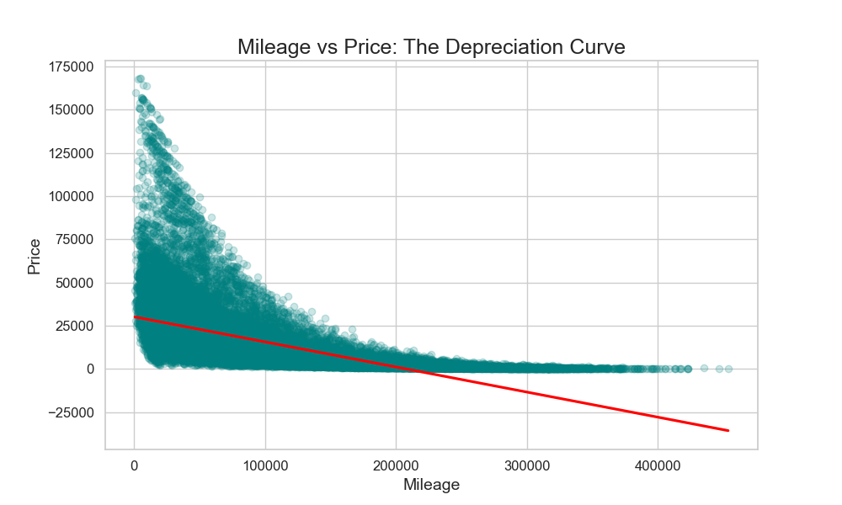
📊 Mileage vs Price: Depreciation Curve
• Sharp value drop before 50,000 miles
• Prices stabilize after ~150,000 miles
• Clear non-linear depreciation behavior
“Most depreciation happens early in a car’s life.”

Slide 6
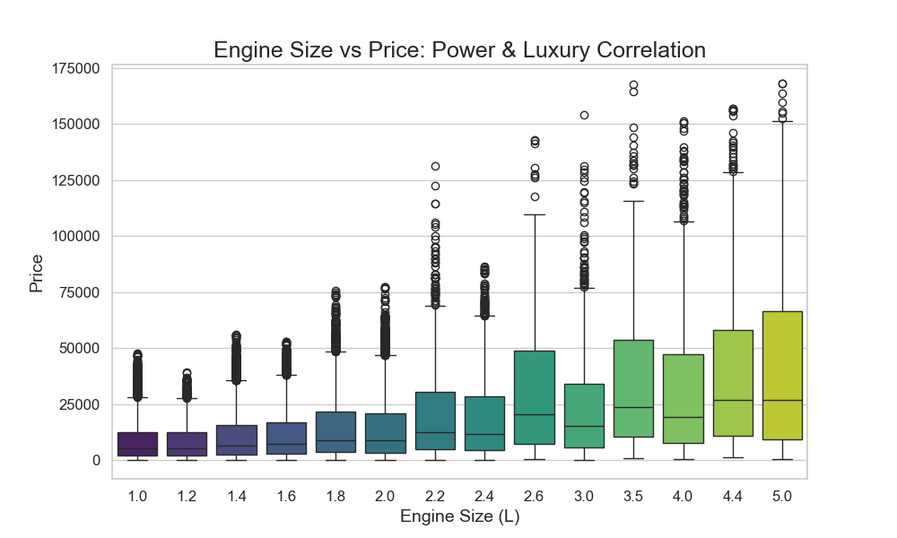
📊 Engine Size vs Price: Market Segmentation
• Engine size strongly influences price segments
• Larger engines consistently command higher prices
• Clear separation between economy and premium segments
“Cars above ~3.0L fall into premium valuation tiers”

Slide 7
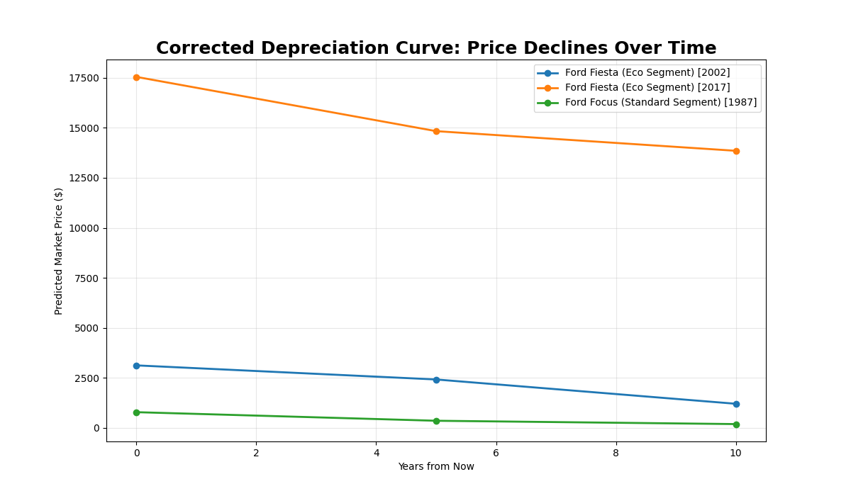
🚀 Future Price Simulation
• Simulates vehicle value over a 10-year horizon
• Mileage increases progressively (~12,000 miles/year)
• Manufacturing year remains constant
• Produces realistic depreciation trends
“This transforms prediction into a forward-looking simulation system”

Slide 8
⚙️ Model & Performance
Model Used
• Random Forest Regressor
Why This Model
• Handles non-linear relationships
• Captures feature interactions effectively
Performance
• R² ≈ 0.97
• MAE ≈ $1400
“Chosen to model real-world non-linear depreciation behavior”

Slide 9
🧠 Key Insights
• 50k mileage cliff → major value drop occurs early
• Terminal value → prices stabilize after high mileage
• Engine segmentation → defines economy vs premium tiers
• Brand impact → premium brands retain value better
“These insights enable smarter buying and selling decisions”

